Slide 1

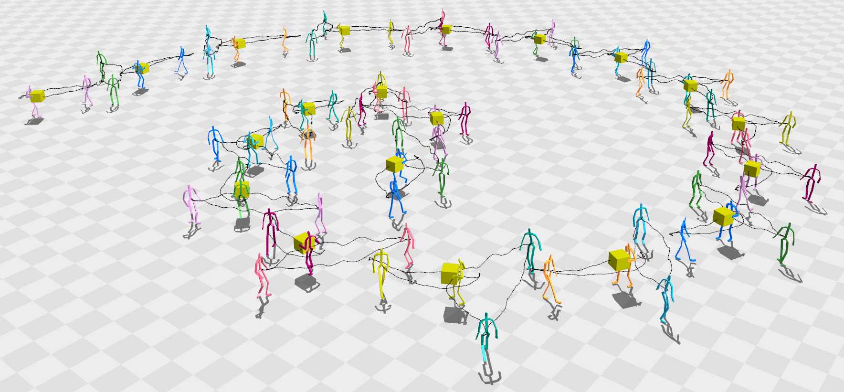
Synchronized Multi-character Motion Editing
Manmyung Kim, Kyunglyul Hyun, Jongmin Kim, Jehee Lee
Seoul National University
Notes:
I'm gonna talk about a new motion editing technique to manipulate synchronized multiple character motion interactively.

Slide 2
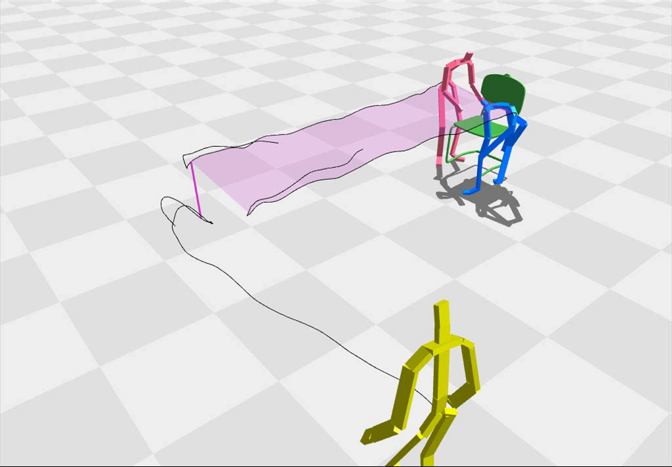
Multi-character Interaction : synchronization in space and time
Notes:
Recently research on multiple characters has emerged in character animation.
Interaction between characters usually requires synchronization in space and time.
The pink and blue characters have to remain at an appropriate relative location with each other while carrying the chair.
And then, the yellow character has to sit down on the chair.

Slide 3
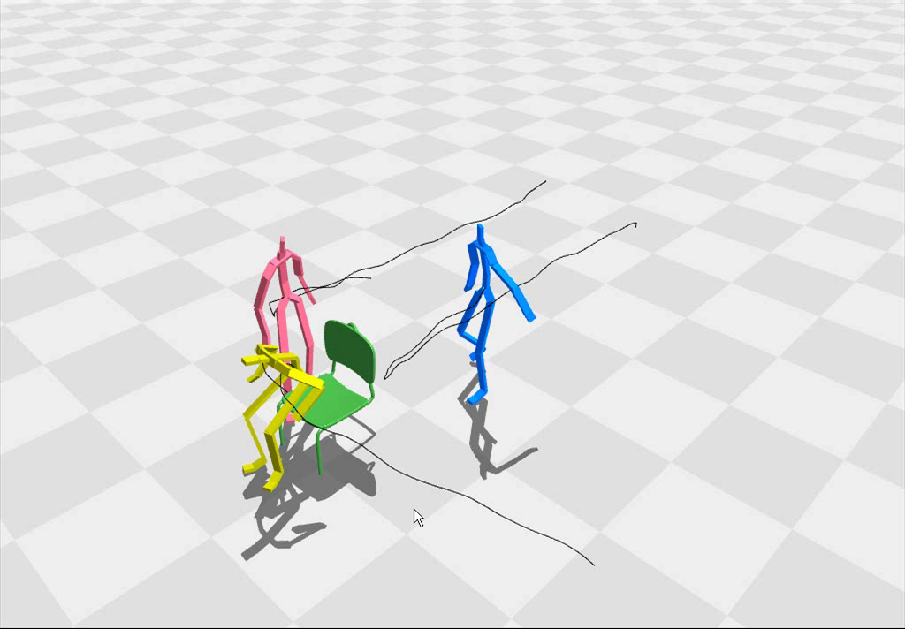
Cumbersome to Maintain Synchronization
Notes:
most existing motion editing techniques allow to manipulate the motion of each individual character independently.
Editing synchronized multi-character motions independently can be cumbersome and difficult if the animator has to maintain synchronization.

Slide 4
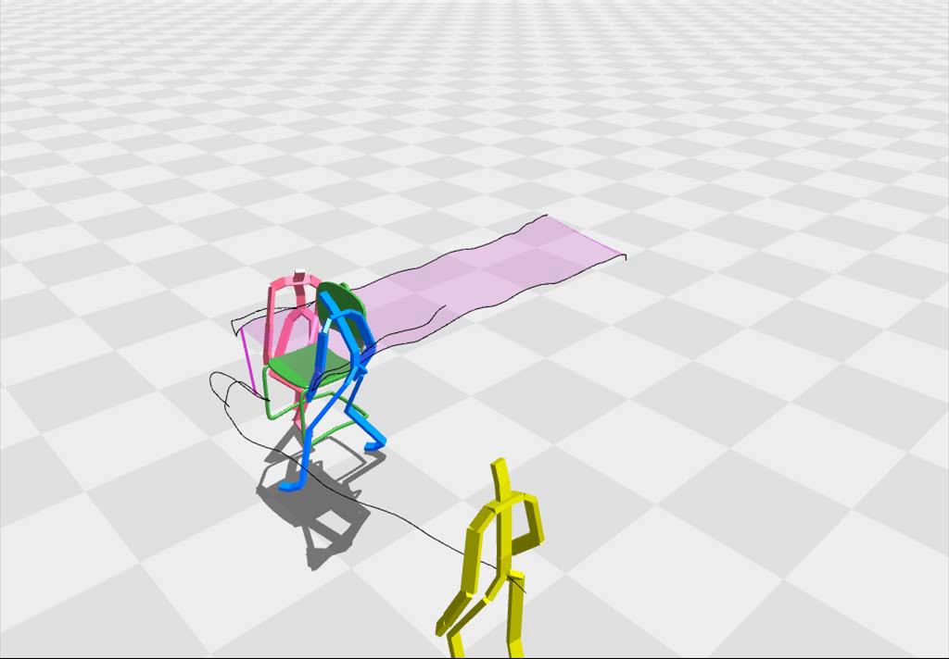
Edit while Maintaining Multiple Character Interaction
Notes:
We present an interactive motion editing technique that allows the animator to edit while maintaining this multiple character interaction such as carrying the chair and sitting down on the chair.

Slide 5
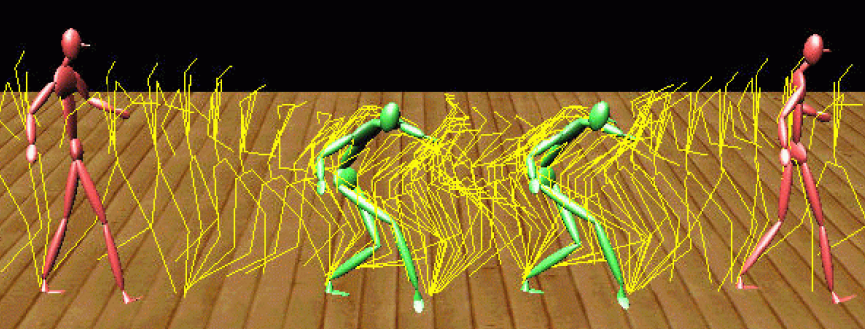
Related Work
Continuous motion editing
make a smooth change to the motion to satisfy user-specified constraints
A hierarchical approach to interactive motion editing for human-like figures.
LEE, SIGGRAPH 99.
Notes:
Given input motion data, continuous editing techniques make a smooth change to the motion to satisfy user-specified constraints.

Slide 6
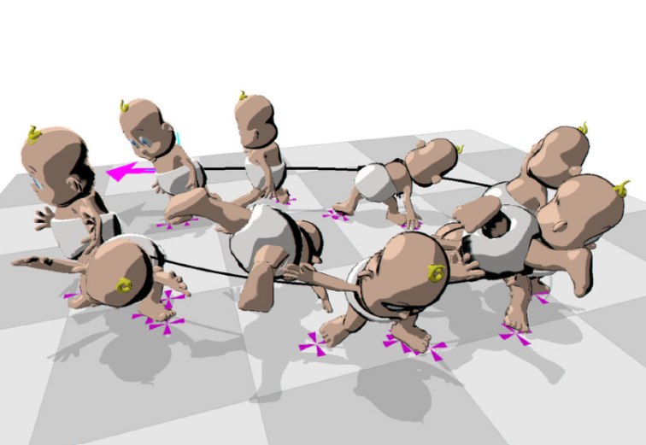
Related Work
Continuous motion editing
make a smooth change to the motion to satisfy user-specified constraints
A hierarchical approach to interactive motion editing for human-like figures.
LEE, SIGGRAPH 99.
Motion path editing.
GLEICHER, I3D 2001.
Notes:
Two-dimensional motion path can be directly manipulated to edit the character's motion in an intuitive manner.

Slide 7
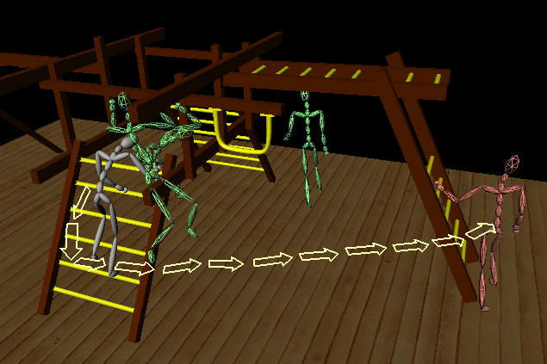
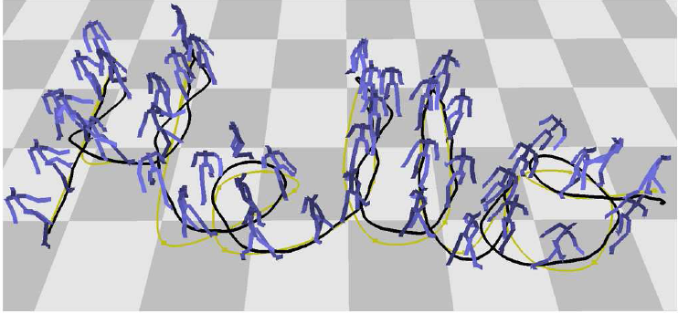
Related Work
Structural motion synthesis
splice motion segments to synthesize a novel motion sequence
Motion Graphs
KOVAR, SIGGRAPH 2002.
Interactive control of avatars animated
with human motion data.
LEE, SIGGRAPH 2002.
Notes:
Structural motion synthesis begins with a set of motion segments and splicing them to synthesize a novel motion sequence.
Continuous and structural editing capabilities are two primary tools for interactive motion editing.
We seamlessly incorporate this structural motion editing capabilities into continuous motion path editing interfaces.

Slide 8
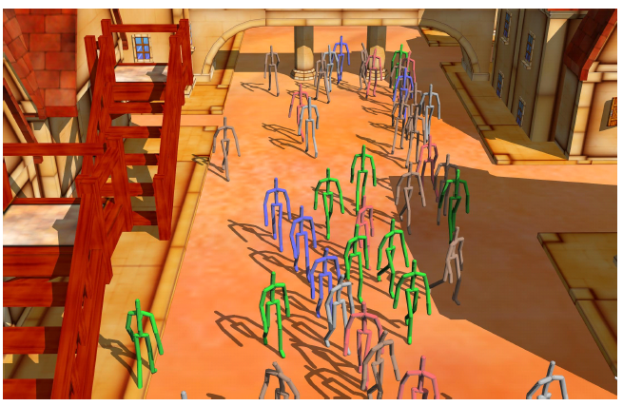
Related Work
Group Motion Editing
the locomotion of pedestrians
Group Motion Editing.
Kwon, SIGGRAPH 2008.
Notes:
Our work is similar to group motion editing in the sense that both addressed editing of multiple characters.
The limitation of group motion editing is that it can handle only the locomotion of pedestrians.
Our work extends the idea to handle arbitrary types of motions and a wider range of inter-personal interaction in our interactive editing system.

Slide 9
Overview
Multiple character interaction
Interactive motion path manipulation
Handling large deformation
Notes:
This is our presentation's overview.
First, I will explain interaction among characters formulated using linear constraints.

Slide 10
Overview
Multiple character interaction
Interactive motion path manipulation
Handling large deformation
Notes:
And then, I will explain our motion path manipulation based on as-rigid-as possible laplacian based techniques.

Slide 11
Overview
Multiple character interaction
Interactive motion path manipulation
Handling large deformation
Notes:
A large deformation of motion paths could result in unnatural distortion of motion.
We will explain how to handle this large deformation.

Slide 12
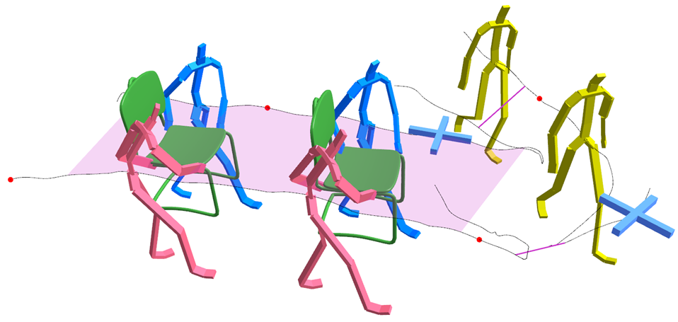
Multiple Character Interaction
Notes:
Multiple character interaction is synchronized both in space and time.
Interaction between characters can be described by specifying their

Slide 13
Multiple Character Interaction
Pinning
position
Notes:
absolute position

Slide 14
Multiple Character Interaction
Pinning
position
Pinning direction
Notes:
and direction,

Slide 15
Multiple Character Interaction
Pinning
position
Pinning direction
Relative
postion & direction
Notes:
relative position and direction of a character with respect to another.

Slide 16
Multiple Character Interaction
Pinning
position
Variational relative
Pinning direction
Relative
postion & direction
Notes:
The relative position of the characters carrying the chair are variational in the sense that it should be enforced for a certain time duration.

Slide 17
Multiple Character Interaction
Pinning
position
Variational relative
Pinning direction
End-effector
Relative
postion & direction
Notes:
The character's hands should stay on the chair.

Slide 18
Multiple Character Interaction
Pinning
position
Variational relative
Pinning direction
End-effector
Relative
postion & direction
Notes:
The bottom three lines represents the time line of the characters.
Each time line governs the timing of corresponding character.
The user can specify

Slide 19
Multiple Character Interaction
Pinning
position
Variational relative
Pinning direction
End-effector
Relative
postion & direction
Absolute time
Notes:
absolute timing

Slide 20
Multiple Character Interaction
Pinning
position
Variational relative
Pinning direction
End-effector
Relative
postion & direction
Absolute time
Synchronization
Notes:
and timing of interaction.

Slide 21
Multiple Character Interaction
Pinning
position
Variational relative
Pinning direction
End-effector
Relative
postion & direction
Absolute time
Synchronization
Formulated as linear equations
Notes:
we formulate all these constraints as linear equations.

Slide 22
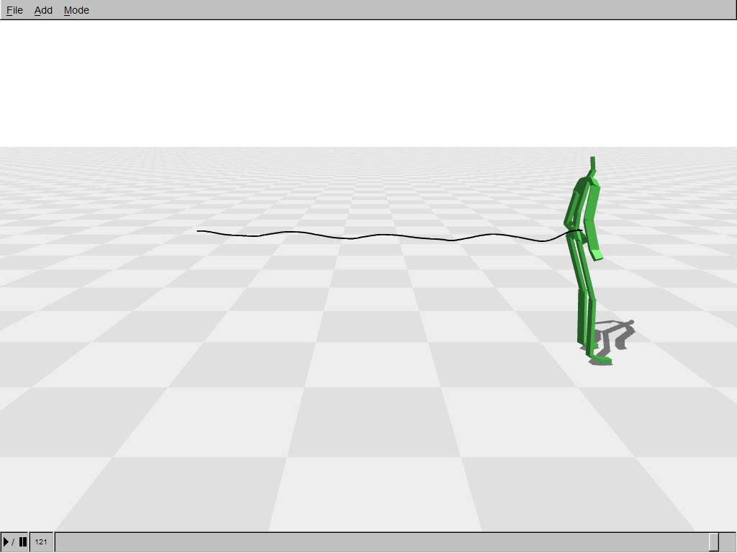
Absolute Position, Direction, and Timing
Notes:
The position, direction, and time at any frame of motion can be directly manipulated.

Slide 23
Absolute Position, Direction, and Timing
Notes:
The red dot represents pinning constraint that fix the location and this blue cross specifies the tangent direction of the path.
The user can specify the timing using the timeline of motion clips.
Manipulating the timeline produces a smooth time-warp function that maps motion frames to the time.

Slide 24
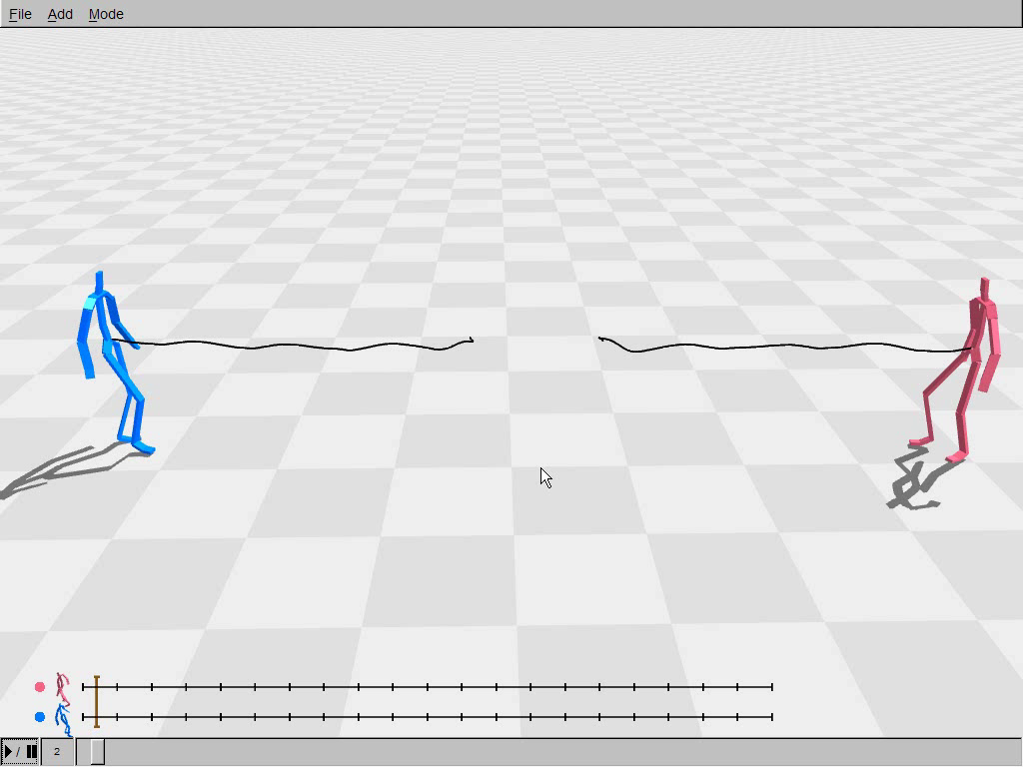
Relative Position, Direction, and Timing
Notes:
Our system allows the motion of multiple characters to be manipulated, spatially-aligned, and temporally-synchronized.
The relative location and direction of a character can be specified with respect to another character.

Slide 25
Relative Position, Direction, and Timing
Notes:
can be specified with respect to another character.
These constraints are persistent during manipulation.
Relative timing can be specified with respect to each other.
And also, the synchronization is maintained during manipulation.

Slide 26
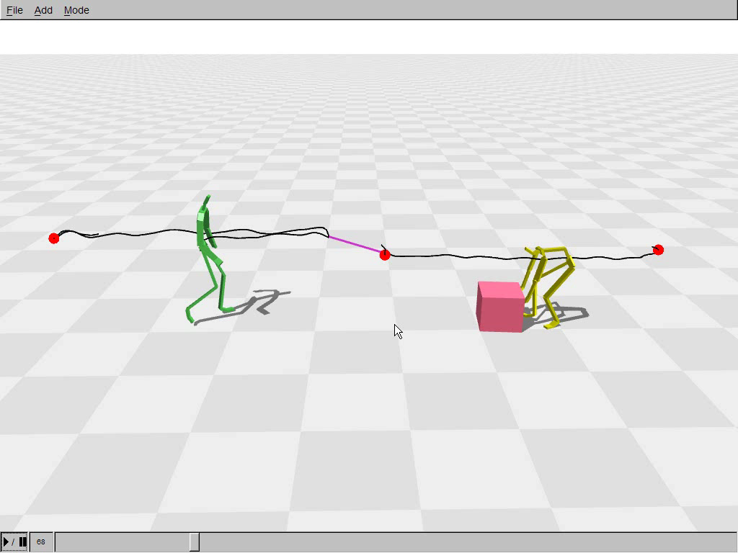
End-effector Constraints
Notes:
Our system provides end-effector constraints to deal with interaction between a character and an object.
In this example, the end-effector constraints keep the both hands of the character stay on the box,
by specifying the position of the hand with respect to the box.

Slide 27
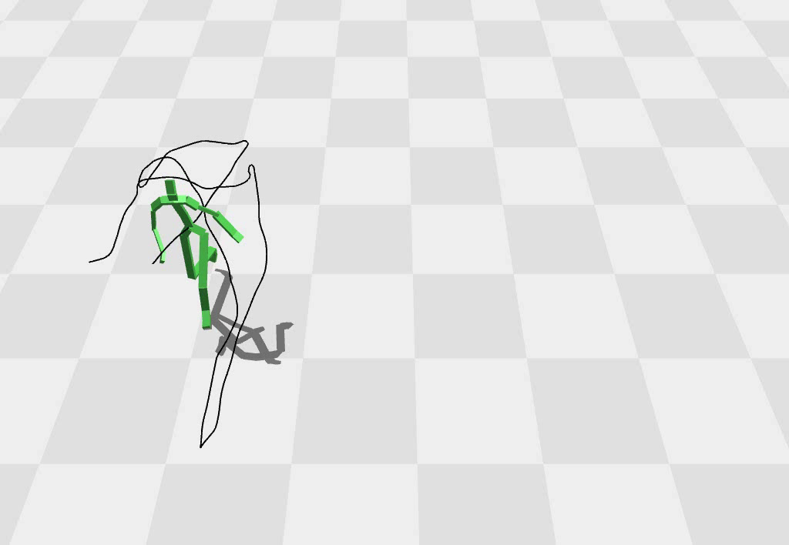

Motion Path Editing
Based on Laplacian mesh editing [Igarash 2005; Sorkine 2004]
deform curve in as-rigid-as possible manner
Linear least squares problems : efficient
Notes:
Our motion path manipulation method is based on one-dimensional version of Laplacian mesh editing.
This method allows a curve to be deformed in an as-rigid-as possible manner.
Because, Laplacian based technique is formulated as a linear least squares problems,
The curve is deformed very efficiently.
We extend Laplacian curve editing method to deal with the character's root trajectory.

Slide 28
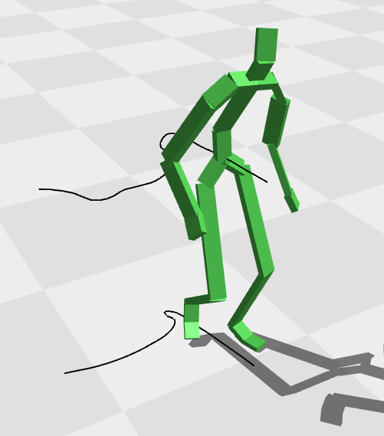
Applying Laplacian formulation to Motion Path
Project root trajectory onto the ground
Notes:
To apply Laplacian formulation to motion path,
our system projects the character's root trajectory onto the ground.

Slide 29
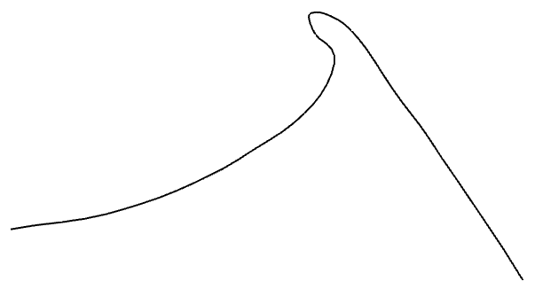
Applying Laplacian formulation to Motion Path
Project root trajectory onto the ground
Define the direction by tangent and normal vectors
Normal
Vector
Tangent
Vector
Notes:
We then define the tangent and normal vectors along the curve.
The character's direction is described with respect to this local coordinate system.

Slide 30
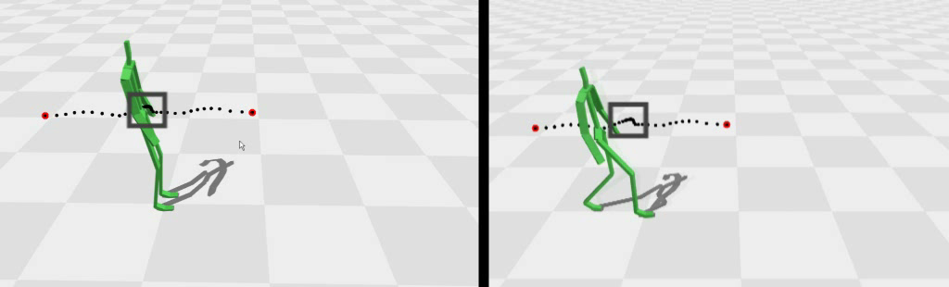
Handling Degenerate Cases : Stationary path
Stationary motion tends to stretch unrealistically
Treat stationary portion as rigid segment using hard constraints
Stretch unrealistically
Treat as rigid segment
Notes:
Two degenerate cases may arise in defining the local coordinates.
The first type of degeneracy is a stationary path.

Slide 31
Handling Degenerate Cases : Stationary path
Stationary motion tends to stretch unrealistically
Treat stationary portion as rigid segment using hard constraints
Stretch unrealistically
Treat as rigid segment
Notes:
Manipulating the stationary motion tends to stretch unrealistically.
Here, the left character moves like an inverted pendulum.
Our system treats a stationary portion of a motion path as a rigid segment using hard constraints.
Then, the unrealistic stretching can be avoided.

Slide 32
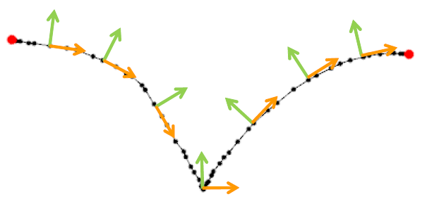
Handling Degenerate Cases : Tangent Flipping
Small deformation could flip tangent directions
Notes:
The second type of degeneracy is tangent flipping.
Small deformation of a motion path could cause a tangent direction to flip.

Slide 33
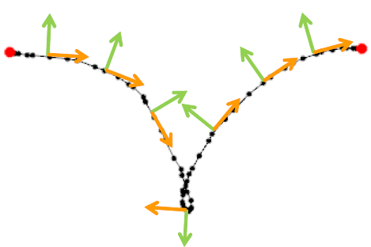
Handling Degenerate Cases : Tangent Flipping
Small deformation could flip tangent directions
Notes:
Here, we squeezed the path gently from both sides, The tangent direction at the middle flips.
A method to detect tangent flipping is explained in the paper.

Slide 34
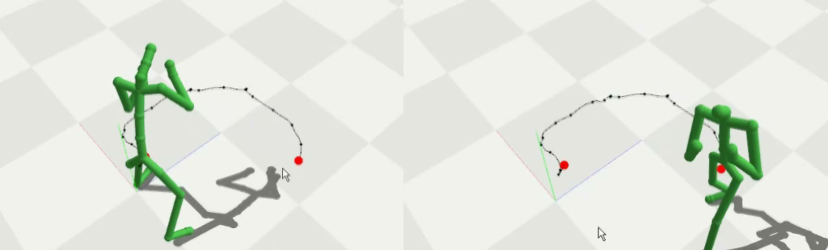
Handling Degenerate Cases : Tangent Flipping
Small deformation cause a tangent direction to flip
Determine new tangent vector by linear interpolation
Tangent flipping
Tangent interpolation
Notes:
Once tangent flipping is detected,
We determine a new tangent vector at that point by linearly interpolating nearby tangent vectors.

Slide 35
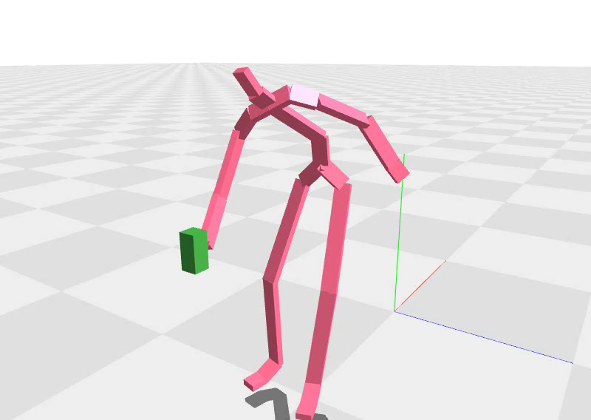
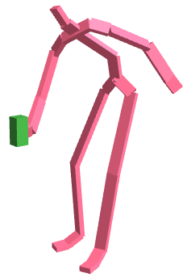
Full-body Refinement
Post-processing touch-up
End-effector constraints involve non-linear equations
: iterative inverse kinematics solver
Pragmatic solution : Motion path editing IK-based refinement
Notes:
The character's full-body motion requires a postprocessing touch-up to enforce end-effector constraints.
While root path editing can be formulated as a very efficient linear formulation,
end-effector constraints involve non-linear equations.
Full-body refinement requires iterative inverse kinematics solver.
The combination of root path editing and IK-based refinement is a pragmatic solution that makes our system fast enough for interactive applications

Slide 36
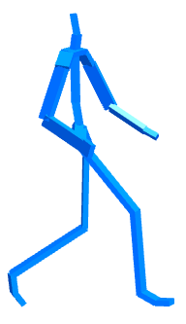
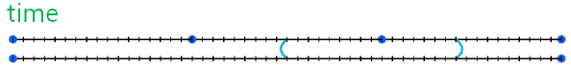
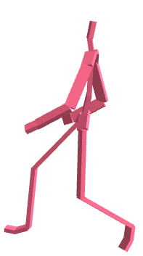
Time Warping
Smooth time-warp to meet timing constraints
Absolute time
Synchronization
Notes:
Our system computes a smooth time-warp to meet user-defined timing constraints.
Here, two character's timelines are synchronized by user constraints.

Slide 37
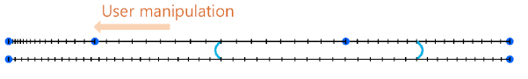
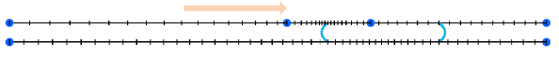
Time Warping
Smooth time-warp to meet timing constraints
Absolute time
Synchronization
User Manipulation
Notes:
Manipulating one timeline warp the other timeline to maintain synchronization.

Slide 38
Time Warping
Smooth time-warp to meet timing constraints
Timeline and spatial path are motion curves
the same Laplacian curve editing method
Notes:
Though a time-warp function is one-dimentional and a spatial path is two-dimentional,
both are motion curves.
So, we use the same Laplacian curve editing method for time warping as well as spatial path editing.

Slide 39
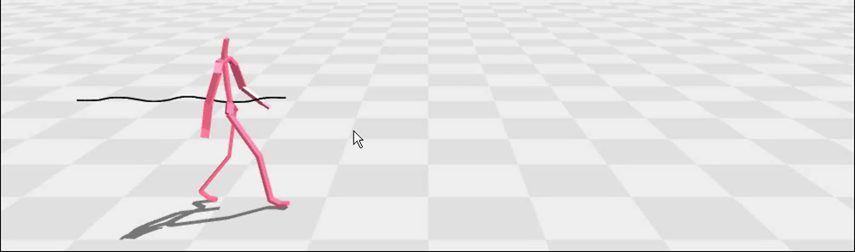
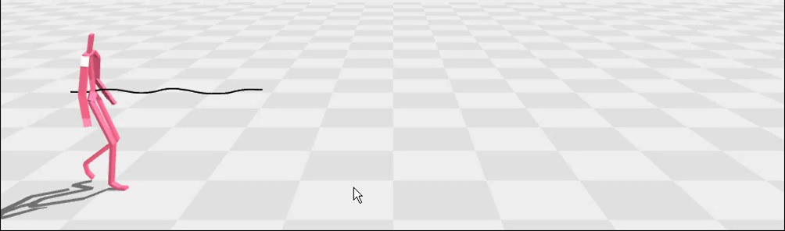
Handling Large Deformation
Only Laplacian path editing
Laplacian path editing Discrete motion editing
Notes:
The large deformation of a motion path often result in unnatural stretching, bending and squeezing of motion.
Excessive stretching of a walking motion entails unrealistically longer strides.

Slide 40
Handling Large Deformation
Only Laplacian path editing
Laplacian path editing Discrete motion editing
Notes:
It would be better to have more steps to cope with excess stretching.

Slide 41
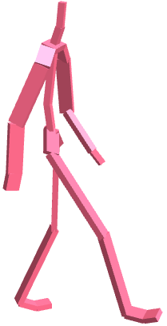
Discrete Transformations
Motion graph
identify similar frames and create transitions
Notes:
We use motion graph to implement discrete, structural editing, such as introducing extra steps into the walking motion.
The motion graph can be automatically constructed by identifying similar frames and creating transitions between these frames.

Slide 42
Discrete Transformations
Motion graph
identify similar frames and create transitions
There are exponentially many sequences of discrete transformations
structurally-varied motion path
Notes:
Generally There are exponentially many sequences of discrete transformations.
Each discrete transformation yields a structurally-varied motion path.

Slide 43
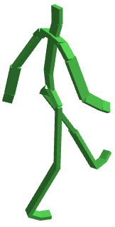
Incremental Change
Interactive editing is inherently incremental
motion path change gradually
Notes:
Interactive editing is inherently incremental and thus sudden jump isn't permitted in manipulation.
Whenever a manipulation handle is updated,
it is reasonable to assume that the motion path would change gradually rather than the system suggests a completely new path

Slide 44
Incremental Change
Interactive editing is inherently incremental
motion path change gradually
Three local transformations : delete, insert, replace
interactive performance & predictable control
Notes:
So, our system uses three local transformations: delete, insert, and replace.
In another point of view, predictability and controllability are key design concepts of interactive user interfaces.
The three local transformations allows not only interactive performance, but also predictable control.

Slide 45
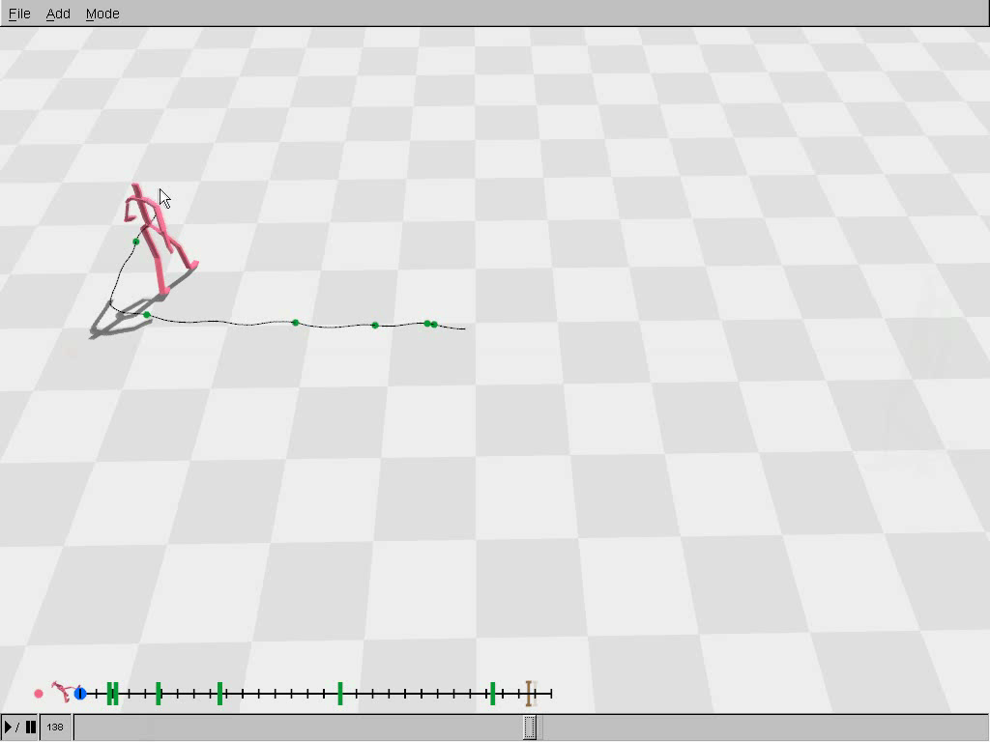
Notes:
In the movie, you can see walking steps are inserted and deleted seamlessly while the user manipulates the handles.
Our system can also replace the straight walking step with turning step.

Slide 46
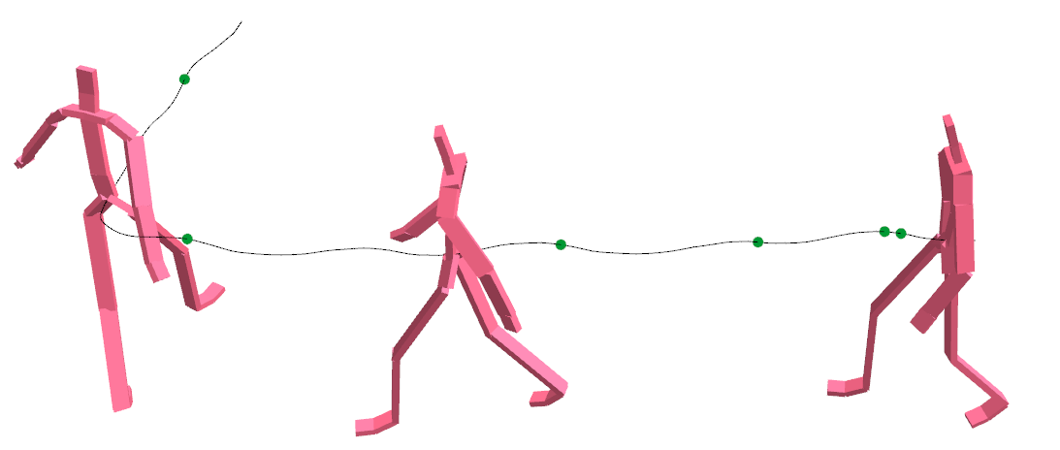
Types of Discrete Transformation
Deletion
Notes:
This is the character's motion and its corresponding path in the motion graph.

Slide 47
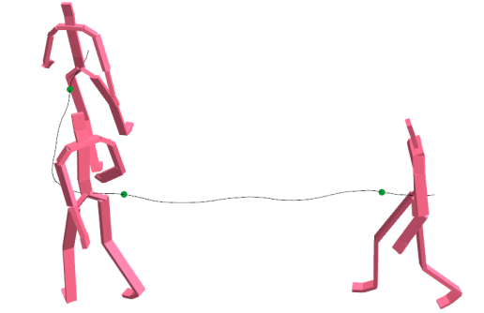
Types of Discrete Transformation
Deletion
Notes:
Traversing the forward transitioning edge in the graph results in the deletion of the motion frames.

Slide 48
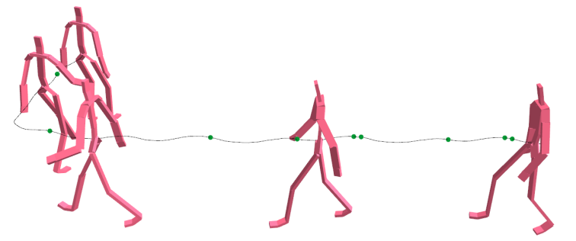
Types of Discrete Transformation
Insertion
Notes:
Traversing the backward transitioning edge results in the duplication of the motion frames.

Slide 49
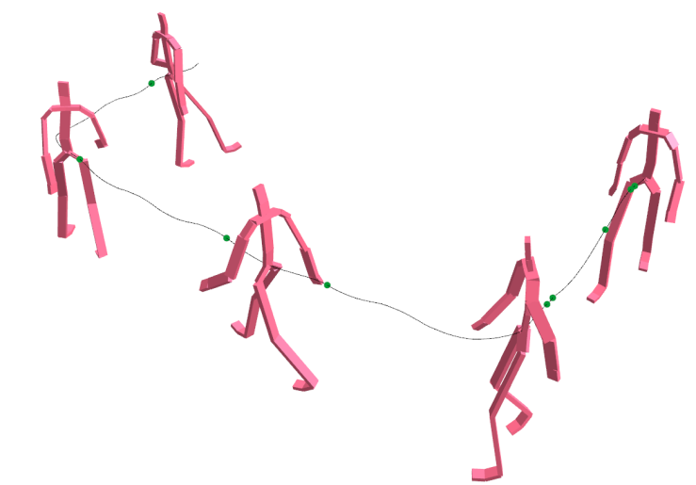
Types of Discrete Transformation
Replacement
Notes:
And also, replacement can be implemented by traversing edges.

Slide 50
Evaluation of Discrete Transformation
Evaluate deformation energy of Laplacian path editing to meet user constraints
E = Espatial Etemporal Epenalty
E_{spatial} : spatial deformation energy
E_{temporal} : temporal deformation energy
E_{penalty} : penalize lengthening and shortening of motion path
Notes:
We need to determine how well each transformed path fits user constraints.
To do so, we run laplacian path editing to meet user constraints
and then evaluate its deformation energy.
Evaluation energy is the sum of spatial deformation energy, temporal deformation energy and penalty term.
Penalty term penalize lengthening and shortening of motion path.
Using this evaluation energy,

Slide 51
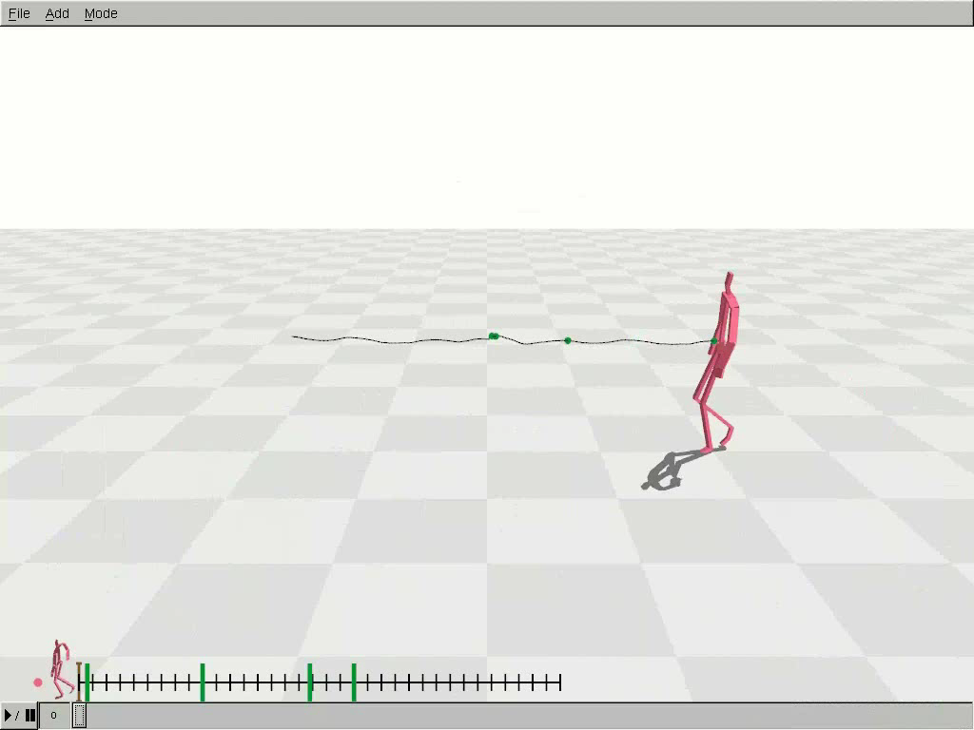
Evaluation and Selection
Notes:
Our discrete editing appropriately evaluate and select a discrete transformation taking account of both spatial and temporal aspects of the motion.

Slide 52
Evaluation and Selection
Notes:
taking account of both spatial and temporal aspects of the motion.
Stretching the motion in space would result in introducing extra cycles of walking to produce a longer spatial path.
Stretching the motion in time would extend idling motions to produce a temporally extended path.

Slide 53
Our Algorithm
Update user constraints
Notes:
This is the overview of our algorithm.
Whenever user constraints are updated,

Slide 54
Our Algorithm
Update user constraints
Enumerate all possible transformations
Notes:
our system enumerates all possible local discrete transformations

Slide 55
Our Algorithm
Update user constraints
Enumerate all possible transformations
Evaluate each transformation to select the best
Notes:
and evaluates each transformation with respect to user constraints, and the best transformation is selected.

Slide 56
Our Algorithm
Update user constraints
Enumerate all possible transformations
Evaluate each transformation to select the best
Laplacian path editing
Notes:
Then, deform the motion path using Laplacian editing techniques.

Slide 57
Our Algorithm
Update user constraints
Enumerate all possible transformations
Evaluate each transformation to select the best
Laplacian path editing
Full-body refinement
Deformed motions
Notes:
Finally, we perform full-body refinement to enforce end-effector constraints.

Slide 58
Our Algorithm
Update user constraints
Enumerate all possible transformations
Evaluate each transformation to select the best
Laplacian path editing
Full-body refinement
Deformed motions
Notes:
We iterate this procedure while the user drags manipulator handles.

Slide 59
Our Algorithm
Update user constraints
Enumerate all possible transformations
Performace
bottleneck
Evaluate each transformation to select the best
Laplacian path editing
Full-body refinement
Deformed motions
Notes:
We often have too many potential discrete transformations to enumerate and evaluate comprehensively. Each evaluation step requires solving Laplacian equations to estimate its deformation energy.
Therefore, we employs acceleration techniques.

Slide 60
Pruning Discrete Transformations
Prune transformations for interactive performance
Duration
Notes:
It is important to prune discrete transformations without evaluating their deformation energy.
A discrete transformation of very long interval causes abrupt visual changes.
A discrete transformation of very short interval occurs too frequently.
we prune long and short transformations.

Slide 61
Pruning Discrete Transformations
Prune transformations for interactive performance
Duration
Enclosing
Notes:
Let's think the case that one interval encloses another.
We assume that user constraints are updated continuously as the user drags a manipulator.
Therefore, the enclosed transformation will be invoked if needed,
and the enclosing transformation can never occur.
we prune an enclosing transformation.

Slide 62
Pruning Discrete Transformations
Prune transformations for interactive performance
Duration
Enclosing
Constraints
Deletion
Notes:
A transformation should not remove any user-defined constraints.
Therefore, transformations that delete or replace any frame specified by user constraints should not be occured.

Slide 63
Subsampling Acceleration Technique
For each discrete transformation, we evaluate its energy by solving Laplacian equations
Subsample motion paths in evaluating its deformation energy
Subsampling ratio is sparse such as 125
Notes:
For each discrete transformation, we evaluate its energe by solving laplacian equations.
For further performance gain, we use subsampled motion paths in evaluating its deformation energy.
In our experiments, the subsampling ratio was sparse, such as 1 over 25.
Solving Laplacian equations with such sparse samples gives a quite reasonable approximation.

Slide 64
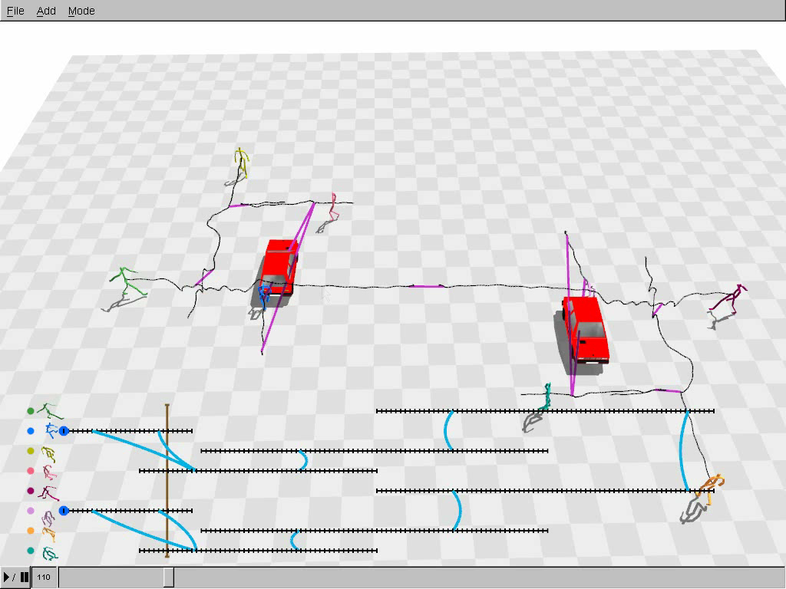
Notes:
let me show our results.
In this example, we have eight characters interacting sequentially.
To make the scene, we prepared four characters’ sequential motions.

Slide 65
Notes:
To make the scene, we prepared four characters’ sequential motions.
Then we copied and manipulated them to get the result.
The pink character dodges, walks, and pushes the yellow character who jumps over the green character.
The entire scene can be manipulated and stretched while maintaining interactions between characters.
This example shows complex interactive scene.

Slide 66
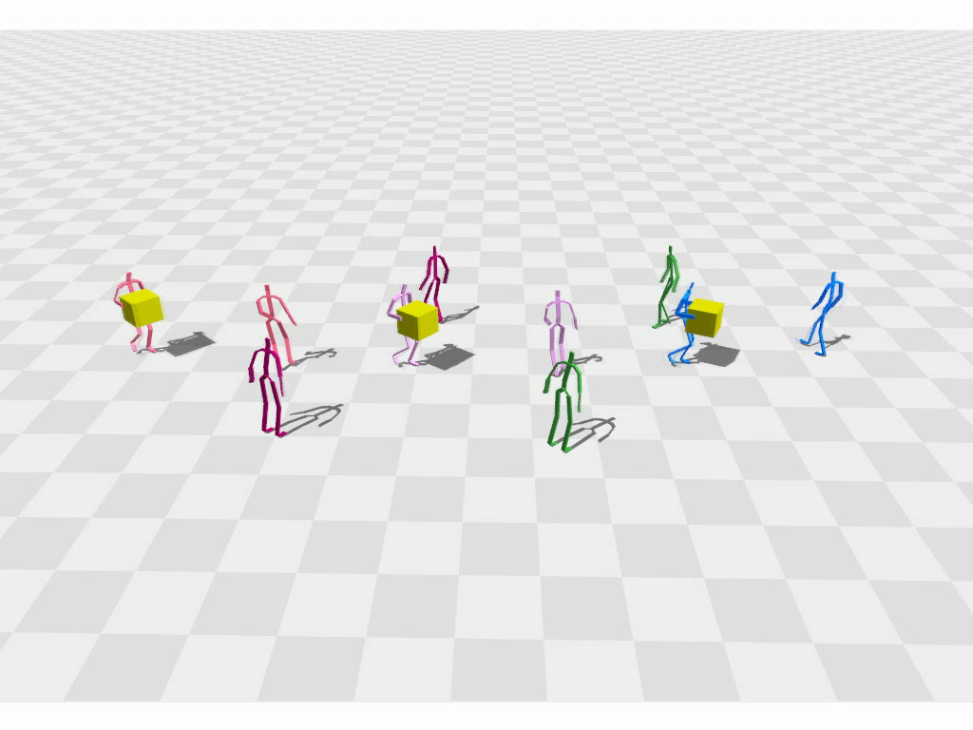
Notes:
This example shows complex interactive scene.
These two characters are passing the box with each other and this green character dodges the box

Slide 67
Notes:
These two characters are passing the box with each other and this green character dodges the box
Each interaction should be carefully coordinated and synchronized.
Relative time constraints are used to synchronize their sequence of actions.

Slide 68
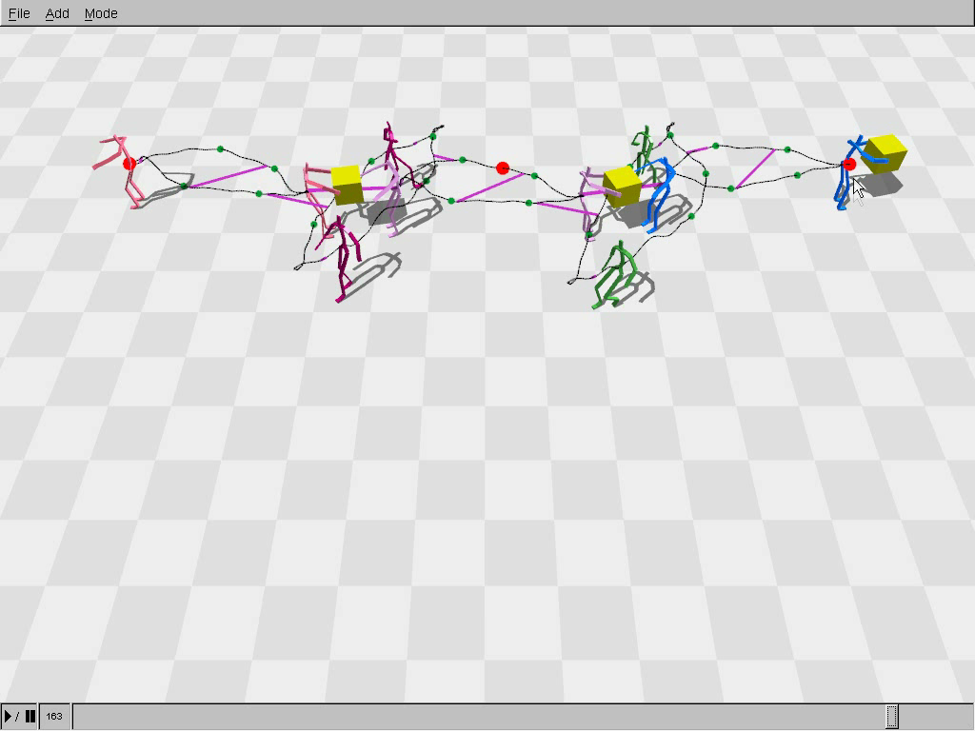
Notes:
Relative time constraints are used to synchronize their sequence of actions.
We extended this example to create 78 characters.
They carry the boxes in relay to form a spiral.

Slide 69
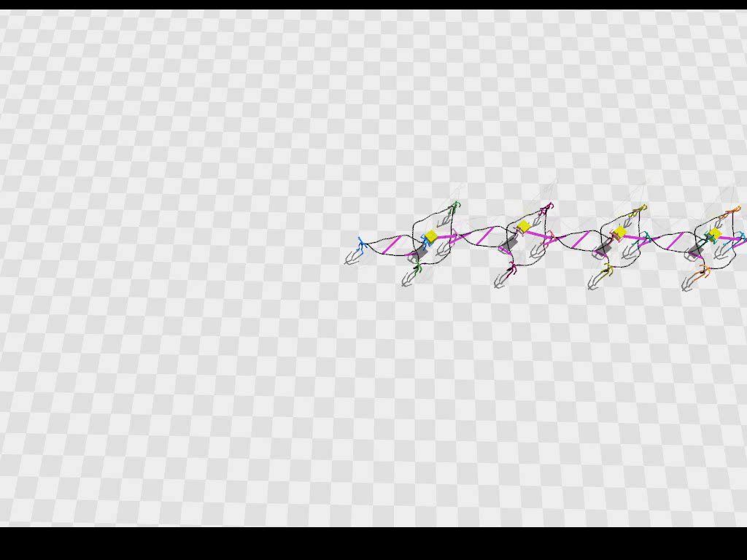
Notes:
We extended this example to create 78 characters.
They carry the boxes in relay to form a spiral.
This scene was created in an off-line manner.
You can see all the characters are still synchronized and coordinated.
This box stacking example shows ten characters dragging, pulling, or carrying boxes to make a stack of boxes.

Slide 70
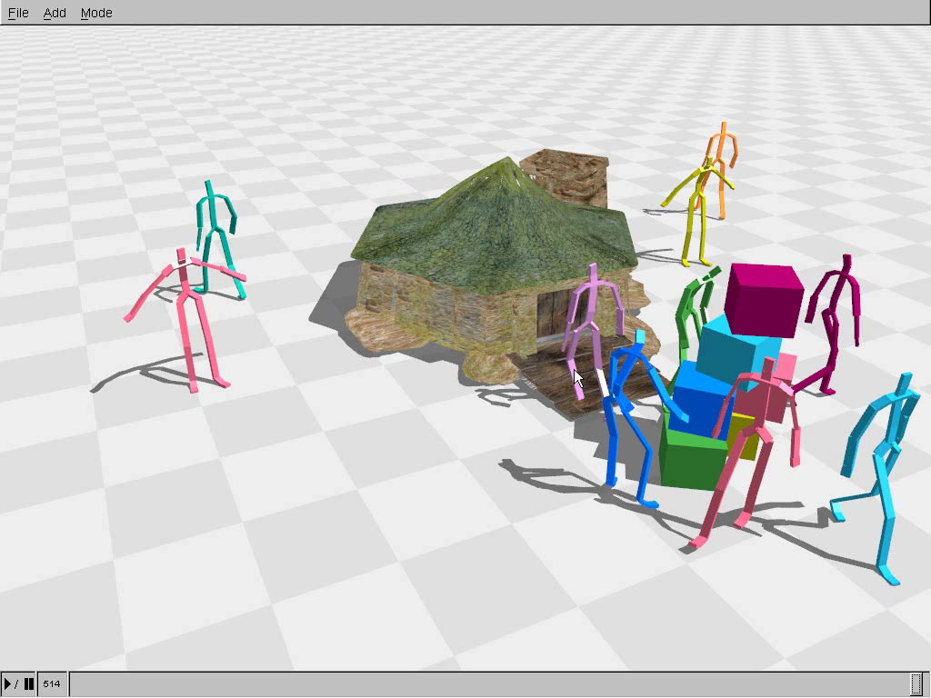
Notes:
This box stacking example shows ten characters dragging, pulling, or carrying boxes to make a stack of boxes.
They are still stacking boxes
This scene was created starting with
these motion clips.
The editing process is as follows.

Slide 71
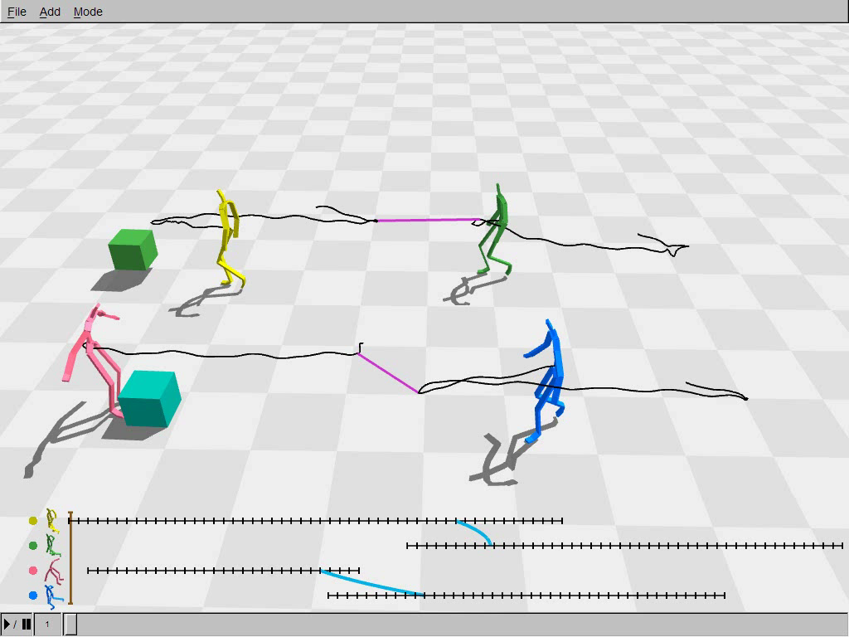
Notes:
This scene was created starting with these motion clips.
The editing process is as follows.
Each motion sequence has relative spatial and time constraints
to specify the timing of the boxes being passed from one character to another
This shows the whole editing process of the scene.

Slide 72
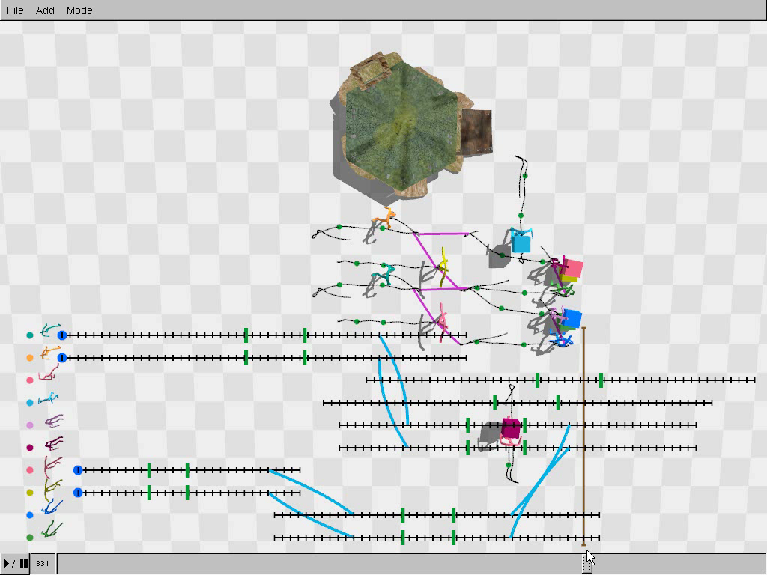
Notes:
This shows the whole editing process of the scene.
We first specified relative time constraints to decide the stacking order of the boxes.
They should stack the boxes from bottom to top as you know
Then we set the initial and final positions and paths of the characters.
Each manipulation took about 400ms so the user is able to edit the scene interactively.
Without our motion editing system, it could have taken hours or maybe days.
This is the final result you saw
Our contribution is threefold.

Slide 73
Discussion
Contribution
a unified formulation of space, time, interaction
combining continuous and discrete motion editing
intuitive interface
Notes:
Our contribution is threefold.
Our unified formulation can deal with spatial, temporal, and inter-personal interaction.
Our system is a framework that seamlessly combines continuous and discrete motion editing capabilities.
Our user interface allows intuitive manipulation of synchronized multi-character motion.
We can easily generalize our method to handle 3-dimensional paths.

Slide 74
Discussion
Contribution
a unified formulation of space, time, interaction
combining continuous and discrete motion editing
intuitive interface
Future works
handling 3D motion path
non-linear constraints
Notes:
We can easily generalize our method to handle 3-dimensional paths.
However editing height of a motion from ground would result in unnatural physics-violating motion.
It can attract more attention if high-quality swimming or flying motions would become available.
Though we chose to use Laplacian curve deformation method for its simplicity and efficiency,
our system can take any other similar techniques developed for as-rigid-as-possible deformation.
Probably, a more flexible non-linear optimization method would allow us to model high-level
social behavior and inter-personal interaction.

Slide 75
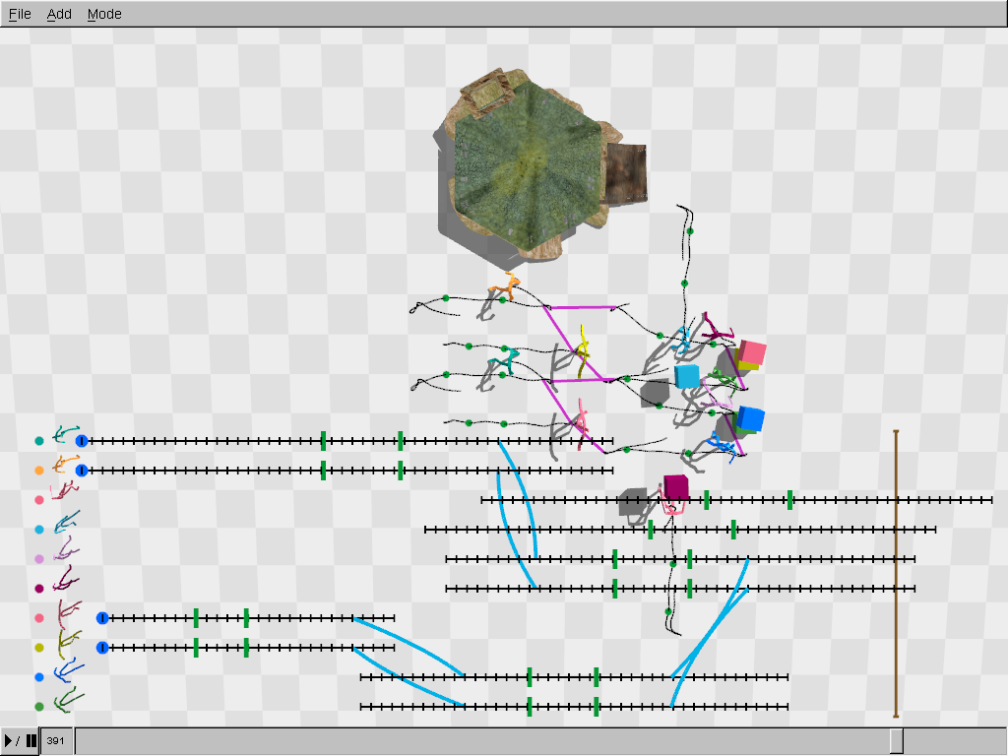
Synchronized Multi-character Motion Editing
Manmyung Kim, Kyunglyul Hyun, Jongmin Kim, Jehee Lee

